Slide 1
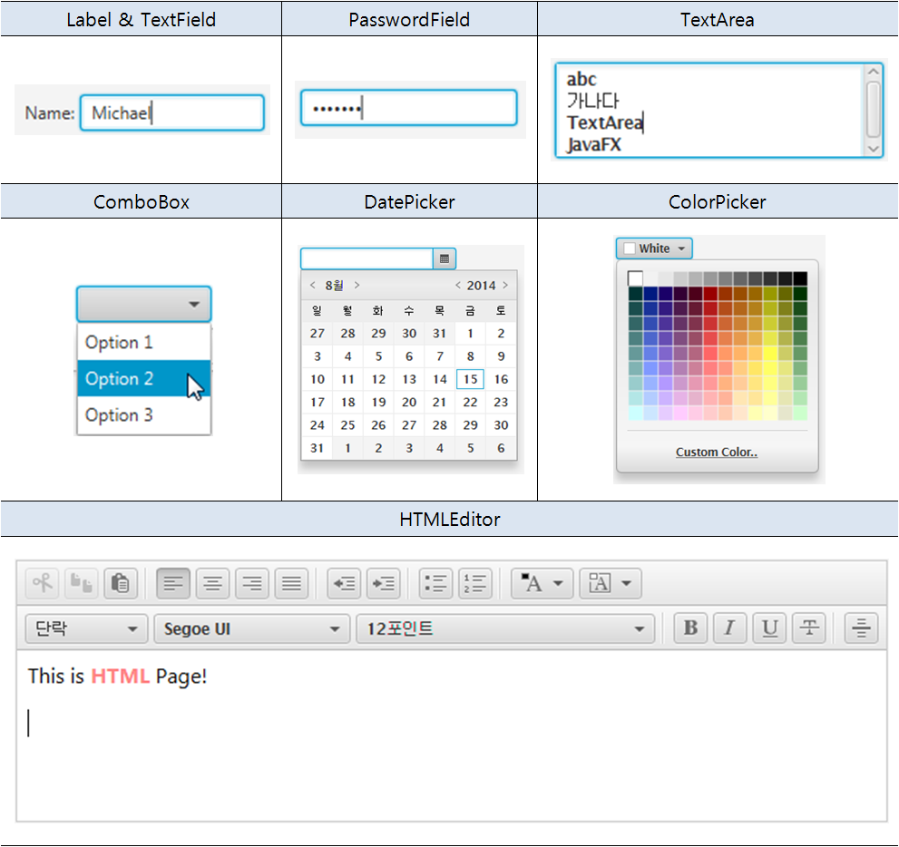
JavaFX Input Controls
입력 컨트롤

Slide 2
Label
생성
주요메소드
setFont
setTextFill / setWrapText
setRotate
setTranslateX / setTranslateY
setScaleX / setScaleY
Image image = new Image(getClass()
.getResourceAsStream("Search.png"));
Label label1 = new Label("Search");
label1.setGraphic(new ImageView(image));

Slide 3
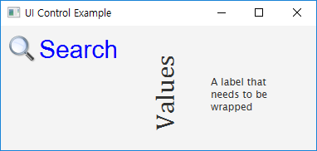
public void start(Stage primaryStage) throws Exception
{
HBox root = new HBox();
root.setPadding(new Insets(10));
root.setSpacing(10);
Image image = new Image(this.getClass()
.getResourceAsStream("Search.png"));
Label label1 = new Label("Search");
label1.setGraphic(new ImageView(image));
label1.setFont(new Font("Arial", 30));
label1.setTextFill(Color.BLUE);
Label label2 = new Label ("Values");
label2.setFont(Font.font("Cambria", 32));
label2.setRotate(270);
label2.setTranslateY(50);
Label label3 = new Label("A label that needs to be wrapped");
label3.setPrefWidth(100);
label3.setWrapText(true);
label3.setTranslateY(50);
전체코드

Slide 4
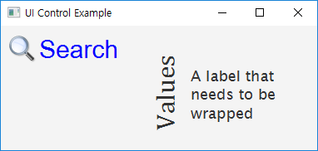
label3.setOnMouseEntered(new EventHandler<MouseEvent>() {
@Override
public void handle(MouseEvent e)
{
label3.setScaleX(1.5);
label3.setScaleY(1.5);
}
});
label3.setOnMouseExited(new EventHandler<MouseEvent>() {
@Override
public void handle(MouseEvent e)
{
label3.setScaleX(1);
label3.setScaleY(1);
}
});
root.getChildren().addAll(label1, label2, label3);
Scene scene = new Scene(root,380,150);
primaryStage.setTitle("UI Control Example");
primaryStage.setScene(scene);
primaryStage.show();
}

Slide 5
TextField
생성
주요 메소드
setText / getText
setPrefColumnCount
너비지정
setPromptText
도움말 출력
clear
TextField name = new TextField();
name.setPrefColumnCount(20);

Slide 6
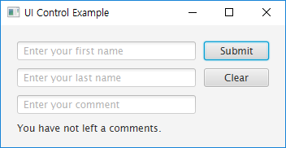
public void start(Stage primaryStage) throws Exception
{
GridPane root = new GridPane();
root.setPadding(new Insets(20));
root.setHgap(10); root.setVgap(10);
TextField name = new TextField();
name.setPrefColumnCount(20);
name.setPromptText("Enter your first name");
Button submit = new Button("Submit");
submit.setPrefWidth(80);
TextField lastName = new TextField();
lastName.setPrefColumnCount(20);
lastName.setPromptText("Enter your last name");
Button clear = new Button("Clear");
clear.setPrefWidth(80);
TextField comment = new TextField();
comment.setPrefColumnCount(20);
comment.setPromptText("Enter your comment");
Label label = new Label("You have not left a comments.");
submit.setOnAction(new EventHandler<ActionEvent>() {
@Override
public void handle(ActionEvent e)
{
전체코드

Slide 7
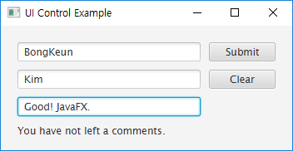
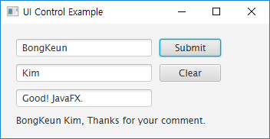
if(!comment.getText().isEmpty() && comment.getText() != null)
label.setText(name.getText() + " "
+ lastName.getText() + ", Thanks for your comment.");
else
label.setText("You have not left a comments.");
}
});
clear.setOnAction(new EventHandler<ActionEvent> () {
@Override
public void handle(ActionEvent event)
{
name.clear(); lastName.clear(); comment.clear();
label.setText("You have not left a comments.");
}
});
// add(object, col_ndx, row_ndx, column_span, row_span)
root.add(name, 0, 0, 2, 1);
root.add(submit, 2, 0, 1, 1);
root.add(lastName, 0, 1, 2, 1);
root.add(clear, 2, 1, 1, 1);
root.add(comment, 0, 2, 2, 1);
root.add(label, 0, 3, 3, 1);
Scene scene = new Scene(root,350,150);
primaryStage.setTitle("UI Control Example");
primaryStage.setScene(scene);
primaryStage.show();
}

Slide 8
TextArea
생성자
TextArea()
TextArea(String text)
주요메소드
getText / setText
setWrapText
setEditable
setPrefColumnCount / setPrefRowCount
appendText
selectRange
getCaretPosition / setCaretPosition

Slide 9
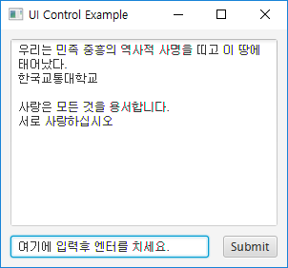
TextArea Example : 전체코드
public void start(Stage primaryStage) throws Exception
{
BorderPane root = new BorderPane();
root.setPadding(new Insets(10));
TextArea textarea = new TextArea();
textarea.setWrapText(true);
textarea.setEditable(false);
textarea.setMaxSize(Double.MAX_VALUE, Double.MAX_VALUE);
GridPane panel = new GridPane();
panel.setHgap(15);
TextField textfield = new TextField();
textfield.setPrefColumnCount(40);
Button btn = new Button("Submit");
panel.add(textfield, 0, 0, 2, 1);
panel.add(btn, 2, 0, 1, 1);
root.setCenter(textarea);
BorderPane.setMargin(panel, new Insets(10, 0, 0, 0));
root.setBottom(panel);

Slide 10
EventHandler<ActionEvent> actionHandler = new
EventHandler<ActionEvent>()
{
@Override
public void handle(ActionEvent event)
{
textarea.appendText(textfield.getText() + "\n");
textarea.selectPositionCaret(textarea.getLength());
textfield.clear();
}
};
textfield.addEventHandler(ActionEvent.ACTION, actionHandler);
btn.addEventHandler(ActionEvent.ACTION, actionHandler);
Scene scene = new Scene(root,300,250);
primaryStage.setTitle("UI Control Example");
primaryStage.setScene(scene);
primaryStage.show();
textfield.requestFocus();
}
public static void main(String[] args)
{
launch(args);
}

Slide 11

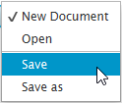
ChoiceBox
생성
ChoiceBox cb1 = new ChoiceBox(
FXCollections.observableArrayList(
"First", "Second", "Third"
)
);
cb1.setValue("First");
ChoiceBox cb2 = new ChoiceBox();
cb2.setItems(
FXCollections.observableArrayList(
"New Document",
"Open ",
new Separator(),
"Save",
"Save as"
)
);
cb2.setValue("New Document");

Slide 12
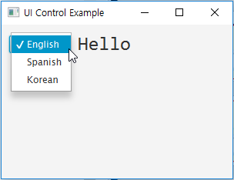
public void start(Stage primaryStage) throws Exception {
FlowPane root = new FlowPane();
root.setPadding(new Insets(10));
root.setHgap(10);
Label label = new Label("Hello");
label.setStyle("-fx-font: 25 Consolas;");
String[] greetings = new String[]{"Hello", "Hola", "안녕하세요"};
ChoiceBox cb = new ChoiceBox(FXCollections.observableArrayList(
"English", "Spanish", "Korean"));
cb.getSelectionModel().selectedIndexProperty()
.addListener(new ChangeListener<Number>() {
public void changed(ObservableValue obv,
Number value, Number new_value) {
label.setText(greetings[new_value.intValue()]);
}
});
cb.setTooltip(new Tooltip("Select the language"));
cb.setValue("English");
root.getChildren().addAll(cb, label);
Scene scene = new Scene(root,300,200);
primaryStage.setTitle("UI Control Example");
primaryStage.setScene(scene);
primaryStage.show();
}
전체코드

Slide 13
ComboBox
생성
선택된 값 읽기
String str = (String)cb.getValue();
ComboBox cb = new ComboBox();
cb.getItems().addAll(
"English",
"Spanish",
"Korean"
);

Slide 14
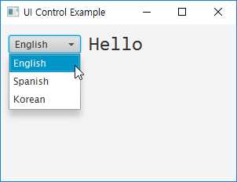
public void start(Stage primaryStage) throws Exception {
FlowPane root = new FlowPane();
root.setPadding(new Insets(10));
root.setHgap(10);
Label label = new Label("Hello");
label.setStyle("-fx-font: 25 Consolas;");
String[] greetings = new String[]{"Hello", "Hola", "안녕하세요"};
ComboBox cb = new ComboBox();
cb.getItems().addAll("English", "Spanish", "Korean");
cb.getSelectionModel().selectedIndexProperty()
.addListener(new ChangeListener<Number>() {
public void changed(ObservableValue obv,
Number value, Number newValue) {
label.setText(greetings[newValue.intValue()]);
}
});
cb.setTooltip(new Tooltip("Select the language"));
cb.setValue("English");
root.getChildren().addAll(cb, label);
Scene scene = new Scene(root,300,200);
primaryStage.setTitle("UI Control Example");
primaryStage.setScene(scene);
primaryStage.show();
}
전체코드

Slide 15
DatePicker
생성
선택된 날짜 읽기
LocalDate value = datePicker.getValue();
value.getYear()
value.getMonthValue()
value.getDayOfMonth()
DatePicker datePicker1 = new DatePicker(
LocalDate.of(2016, 1, 28));
DatePicker datePicker2 = new DatePicker();
datePicker2.setValue(LocalDate.now());

Slide 16
전체코드
public void start(Stage primaryStage) throws Exception {
VBox root = new VBox();
root.setPadding(new Insets(10));
root.setSpacing(5);
Label label = new Label("Selected Date : ");
StringConverter<LocalDate> converter =
new StringConverter<LocalDate>()
{
DateTimeFormatter dateFormatter
= DateTimeFormatter.ofPattern("yyyy-MM-dd");
@Override
public LocalDate fromString(String str)
{
if(str != null && !str.isEmpty())
return LocalDate.parse(str, dateFormatter);
else
return null;
}
@Override
public String toString(LocalDate date)
{
if(date != null)
return dateFormatter.format(date);
else
return null;
}
};

Slide 17
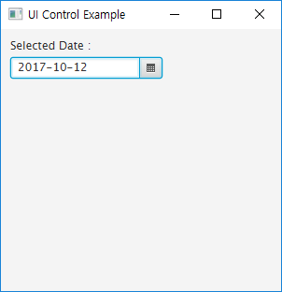
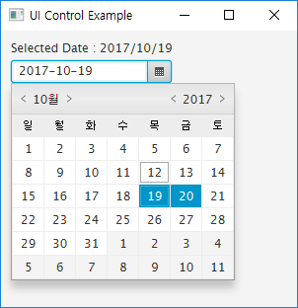
DatePicker datePicker = new DatePicker();
datePicker.setValue(LocalDate.now());
datePicker.setShowWeekNumbers(false);
datePicker.setConverter(converter);
datePicker.setPromptText("yyyy-MM-dd");
datePicker.setOnAction(event->{
LocalDate value = datePicker.getValue();
label.setText("Selected Date : " + value.getYear()
+ "/" + value.getMonthValue()
+ "/" + value.getDayOfMonth());
});
root.getChildren().addAll(label, datePicker);
Scene scene = new Scene(root,300,280);
primaryStage.setTitle("UI Control Example");
primaryStage.setScene(scene);
primaryStage.show();
}

Slide 18
ColorPicker
생성
색상 얻기/변경
getValue / setValue
컨테이너의 배경인 경우,
root.setStyle("-fx-background-color: black");
컴포넌트의 배경인 경우,
circle.setFill(colorPicker2.getValue());
ColorPicker colorPicker2 = new ColorPicker();
colorPicker2.setValue(Color.RED);

Slide 19
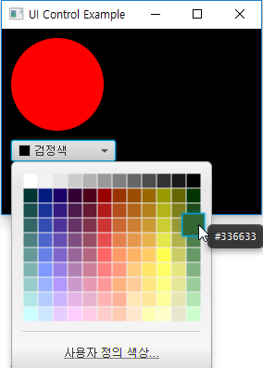
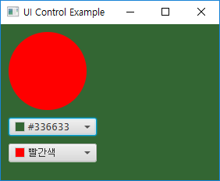
public void start(Stage primaryStage) throws Exception
{
VBox root = new VBox();
root.setPadding(new Insets(10));
root.setSpacing(10);
root.setStyle("-fx-background-color: black");
Circle circle = new Circle(50);
circle.setFill(Color.RED);
ColorPicker colorPicker1 = new ColorPicker();
colorPicker1.setValue(Color.BLACK);
colorPicker1.setOnAction(event->{
root.setStyle("-fx-background-color: #"
+ colorPicker1.getValue().toString().substring(2)); // remove 0x
});
ColorPicker colorPicker2 = new ColorPicker();
colorPicker2.setValue(Color.RED);
colorPicker2.setOnAction(event->{
circle.setFill(colorPicker2.getValue());
});
root.getChildren().addAll(circle, colorPicker1, colorPicker2);
Scene scene = new Scene(root,280,200);
primaryStage.setTitle("UI Control Example");
primaryStage.setScene(scene);
primaryStage.show();
}
전체코드

Slide 20
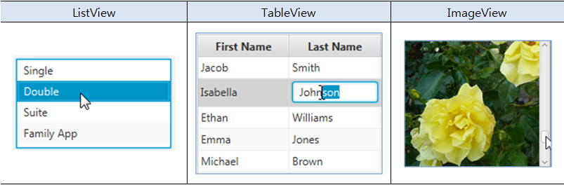
JavaFX View Controls
뷰 컨트롤
목록 형태로 보여주는 ListView
테이블 형태로 보여주는 TableView
이미지를 보여주는 ImageView

Slide 21
ListView
생성
다중선택 가능하게 하기
ListView list = new ListView ();
list.getItems().add("Apple");
list.getItems().add("Banana");
list.getItems().add("Kiwi");
list.getItems().add("Mango");
list.getItems().add("Berry");
String[] names = {"Apple", "Banana", "Kiwi", "Mango", "Berry"};
ListView<String> list = new ListView<String>();
list.getItems().addAll(names);
list.getSelectionModel()
.setSelectionMode(SelectionMode.MULTIPLE);

Slide 22
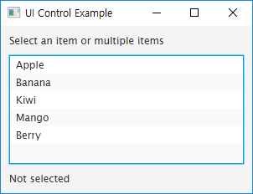
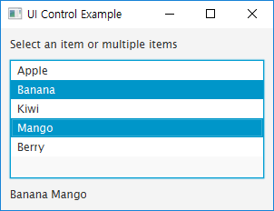
public void start(Stage primaryStage) throws Exception
{
primaryStage.setTitle("UI Control Example");
BorderPane root = new BorderPane();
root.setPadding(new Insets(10));
Label label = new Label("Not selected");
String[] names = {"Apple", "Banana", "Kiwi", "Mango", "Berry"};
ListView<String> list = new ListView<String>();
list.getItems().addAll(names);
list.getSelectionModel().setSelectionMode(SelectionMode.MULTIPLE);
list.getSelectionModel().selectedIndexProperty()
.addListener(new ChangeListener<Number>() {
@Override
public void changed(ObservableValue<? extends Number> obv,
Number oldValue, Number newValue)
{
String str = "";
ObservableList selIndices = list.getSelectionModel().getSelectedIndices();
for(Object obj : selIndices) {
str += names[obj.hashCode()] + " ";
}
label.setText(str);
}
});
root.setTop(new Label("Select an item or multiple items"));
root.setCenter(list);
root.setBottom(label);
BorderPane.setMargin(list, new Insets(10, 0, 10, 0));
Scene scene = new Scene(root,300,200);
primaryStage.setScene(scene);
primaryStage.show();
}
전체코드

Slide 23
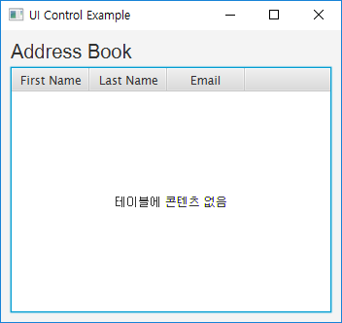
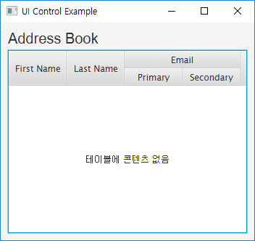
TableView
생성 & 컬럼추가
중첩컬럼추가
TableView table = new TableView();
TableColumn firstNameCol = new TableColumn("First Name");
TableColumn lastNameCol = new TableColumn("Last Name");
TableColumn emailCol = new TableColumn("Email");
table.getColumns().addAll(firstNameCol, lastNameCol, emailCol);
TableView table = new TableView();
...
TableColumn emailCol = new TableColumn("Email");
TableColumn firstEmailCol = new TableColumn("Primary");
TableColumn secondEmailCol = new TableColumn("Secondary");
emailCol.getColumns().addAll(firstEmailCol, secondEmailCol);
table.getColumns().addAll(firstNameCol, lastNameCol, emailCol);

Slide 24
초기 데이터 정의
ObservableList로 정의
각 요소의 변화를 tracking하는 것이 가능하기 때문임
순서
데이터 객체를 위한 class 정의
public class로 정의, 각 컬럼 관련 데이터는 Property로
ObservableList를 생성
데이터 클래스 인스턴스의 리스트 정의
각 컬럼과 데이터 프로퍼티를 연결
PropertyValueFactory 객체를 각 컬럼에 등록
테이블에 데이터를 등록
table.setItems(data);

Slide 25
public class Person
{
private SimpleStringProperty firstName;
private SimpleStringProperty lastName;
private SimpleStringProperty email;
public Person(String fName, String lName, String email)
{
this.firstName = new SimpleStringProperty(fName);
this.lastName = new SimpleStringProperty(lName);
this.email = new SimpleStringProperty(email);
}
public String getFirstName() {
return this.firstName.get();
}
public void setFirstName(String fName) {
this.firstName.set(fName);
}
public String getLastName() {
return this.lastName.get();
}
public void setLastName(String fName) {
this.lastName.set(fName);
}
public String getEmail() {
return this.email.get();
}
public void setEmail(String fName) {
this.email.set(fName);
}
}

Slide 26
ObservableList 생성
ObservableList<Person> data = FXCollections.observableArrayList(
new Person("Jacob", "Smith",
"jacob.smith@example.com"),
new Person("Isabella", "Johnson",
"isabella.johnson@example.com"),
new Person("Ethan", "Williams",
"ethan.williams@example.com"),
new Person("Emma", "Jones",
"emma.jones@example.com"),
new Person("Michael", "Brown",
"michael.brown@example.com")
);

Slide 27
컬럼과 데이터 Property 연결
테이블에 데이터 등록
TableColumn firstNameCol = new TableColumn("First Name");
firstNameCol.setCellValueFactory(
new PropertyValueFactory<Person, String>("firstName")
);
TableColumn lastNameCol = new TableColumn("Last Name");
lastNameCol.setCellValueFactory(
new PropertyValueFactory<Person, String>("lastName")
);
TableColumn emailCol = new TableColumn("Email");
emailCol.setCellValueFactory(
new PropertyValueFactory<Person, String>("email")
);
table.setItems(data);

Slide 28
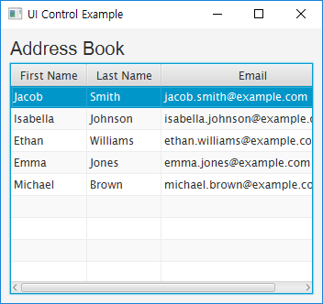
public class Main extends Application
{
TableView<Person> table = new TableView<Person>();
final ObservableList<Person> data = FXCollections.observableArrayList(
new Person("Jacob", "Smith", "jacob.smith@example.com"),
new Person("Isabella", "Johnson", "isabella.johnson@example.com"),
new Person("Ethan", "Williams", "ethan.williams@example.com"),
new Person("Emma", "Jones", "emma.jones@example.com"),
new Person("Michael", "Brown", "michael.brown@example.com")
);
@Override
public void start(Stage primaryStage) throws Exception
{
primaryStage.setTitle("UI Control Example");
VBox root = new VBox();
root.setPadding(new Insets(10));
root.setSpacing(5);
Label label = new Label("Address Book");
label.setFont(new Font("Arial", 20));
table.setEditable(true);
TableColumn firstNameCol = new TableColumn("First Name");
firstNameCol.setCellValueFactory(
new PropertyValueFactory<Person, String>("firstName"));
TableColumn lastNameCol = new TableColumn("Last Name");
lastNameCol.setCellValueFactory(
new PropertyValueFactory<Person, String>("lastName"));
전체코드

Slide 29
TableColumn emailCol = new TableColumn("Email");
emailCol.setCellValueFactory(
new PropertyValueFactory<Person, String>("email"));
table.getColumns().addAll(firstNameCol, lastNameCol, emailCol);
table.setItems(data);
root.getChildren().addAll(label, table);
Scene scene = new Scene(root,350,300);
primaryStage.setScene(scene);
primaryStage.show();
}
public class Person
{
private SimpleStringProperty firstName;
private SimpleStringProperty lastName;
private SimpleStringProperty email;
public Person(String fName, String lName, String email)
{
this.firstName = new SimpleStringProperty(fName);
this.lastName = new SimpleStringProperty(lName);
this.email = new SimpleStringProperty(email);
}
public String getFirstName() {
return this.firstName.get();
}

Slide 30
public void setFirstName(String fName) {
this.firstName.set(fName);
}
public String getLastName() {
return this.lastName.get();
}
public void setLastName(String fName) {
this.lastName.set(fName);
}
public String getEmail() {
return this.email.get();
}
public void setEmail(String fName) {
this.email.set(fName);
}
}
public static void main(String[] args) {
launch(args);
}
}

Slide 31
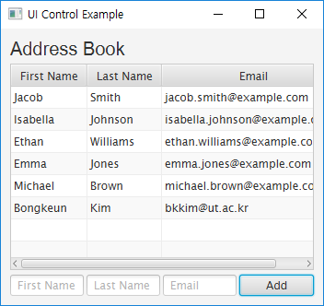
데이터 추가 이벤트 처리
addButton.setOnAction(new EventHandler<ActionEvent>() {
@Override
public void handle(ActionEvent e) {
data.add(new Person(addFirstName.getText(),
addLastName.getText(),
addEmail.getText())
);
addFirstName.clear();
addLastName.clear();
addEmail.clear();
}
});

Slide 32
HBox hb = new HBox();
hb.setSpacing(3);
TextField addFirstName = new TextField();
addFirstName.setPromptText("First Name");
addFirstName.setMaxWidth(firstNameCol.getPrefWidth());
TextField addLastName = new TextField();
addLastName.setMaxWidth(lastNameCol.getPrefWidth());
addLastName.setPromptText("Last Name");
TextField addEmail = new TextField();
addEmail.setMaxWidth(emailCol.getPrefWidth());
addEmail.setPromptText("Email");
Button addButton = new Button("Add");
addButton.setMaxWidth(Double.MAX_VALUE);
HBox.setHgrow(addButton, Priority.ALWAYS);
addButton.setOnAction(new EventHandler<ActionEvent>() {
@Override
public void handle(ActionEvent e) {
data.add(new Person(addFirstName.getText(),
addLastName.getText(),
addEmail.getText())
);
addFirstName.clear();
addLastName.clear();
addEmail.clear();
}
});
hb.getChildren().addAll(addFirstName, addLastName, addEmail, addButton);
root.getChildren().addAll(label, table, hb);
추가된 코드

Slide 33
ImageView
Image
지원포맷 : bmp, gif, png, jpg
주요 메소드
setX, setY
setFitWidth, setFitHeight
setPreserveRatio
ImageView
display images
주요 메소드
setRotate
setScale

Slide 34
Image Loading
from InputStream
from URL
//Passing FileInputStream object as a parameter
FileInputStream inputstream = new FileInputStream("image.jpg");
Image image = new Image(inputstream);
//Loading image from URL
//Image image = new Image(new FileInputStream("url"));
ImageView imageView = new ImageView(image);
String url = "http://somdomain/image.jpg";
Boolean backgroundLoading = true;
Image image = new Image(url, backgroundLoading);
ImageView imageView = new ImageView(image);

Slide 35
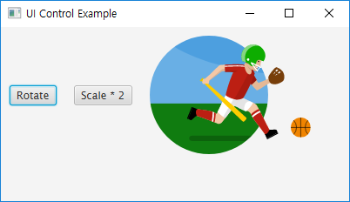
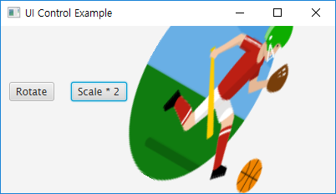
public void start(Stage primaryStage) throws Exception {
primaryStage.setTitle("UI Control Example");
FlowPane root = new FlowPane();
root.setPadding(new Insets(10));
root.setHgap(20);
Button btnRotate = new Button("Rotate");
Button btnScale = new Button("Scale * 2");
Image image = new Image(new FileInputStream(".\\welcome.png"));
ImageView imageView = new ImageView(image);
btnRotate.setOnAction(event->{
double value = imageView.getRotate();
imageView.setRotate(value + 30);
});
btnScale.setOnAction(event->{
if(imageView.getScaleY() == 1.0)
imageView.setScaleY(2);
else
imageView.setScaleY(1);
});
root.getChildren().addAll(btnRotate, btnScale, imageView);
Scene scene = new Scene(root,400,200);
primaryStage.setScene(scene);
primaryStage.show();
}
전체코드

Slide 36
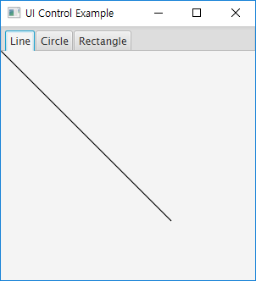
TabPane
Tab 그룹사이를 전환하는 컨트롤
한번에 하나의 Tab만 보임
생성
주요 메소드
setText / setContent
setCloseable
TabPane tabPane = new TabPane();
Tab tab1 = new Tab("Line");
Tab tab2 = new Tab("Circle");
Tab tab3 = new Tab();
tab3.setText("Rectangle");
tabPane.getTabs().addAll(tab1, tab2, tab3);

Slide 37
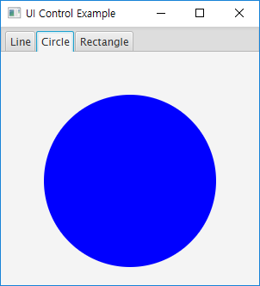
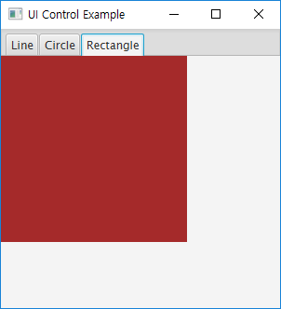
public void start(Stage primaryStage) throws Exception {
primaryStage.setTitle("UI Control Example");
StackPane root = new StackPane();
TabPane tabPane = new TabPane();
Tab tab1 = new Tab("Line");
tab1.setContent(new Line(50, 50, 250, 250));
tab1.setClosable(false);
Tab tab2 = new Tab("Circle");
AnchorPane pane = new AnchorPane();
pane.getChildren().add(new Circle(150, 150, 100, Color.BLUE));
tab2.setContent(pane);
tab2.setClosable(false);
Tab tab3 = new Tab();
tab3.setText("Rectangle");
tab3.setContent(new Rectangle(200, 200, Color.BROWN));
tab3.setClosable(false);
tabPane.getSelectionModel().select(1);
tabPane.getTabs().addAll(tab1, tab2, tab3);
root.getChildren().add(tabPane);
Scene scene = new Scene(root,300,300);
primaryStage.setScene(scene);
primaryStage.show();
}
전체코드

